Slide 1

IT Application and Data Security - Unit IV
- Dr. Gopal Rawat

Slide 2
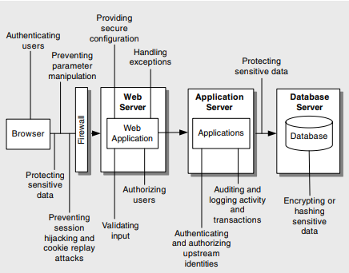
Web Application: Design Issues

Slide 3
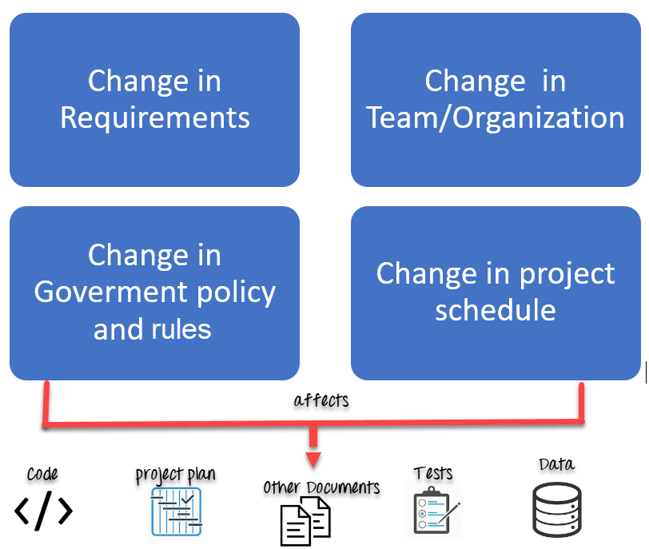
Configuration Management
“process for maintaining computer systems, servers, and software in a desired, consistent state”

Slide 4
Configuration Management
Top configuration management threats include:
Unauthorized access to administration interfaces
Unauthorized access to configuration stores
Retrieval of plaintext configuration secrets
Lack of individual accountability
Over-privileged process and service accounts
A05 Security Misconfiguration - OWASP Top 10:2021

Slide 5
Configuration Management …
Unauthorized Access to Administration Interfaces
Administration interfaces are often provided through additional Web pages or separate Web applications
allow administrators, operators, and content developers to manage site content and configuration
Malicious users able to access a configuration management function
deface the Web site
access downstream systems and databases
take the application out of action altogether by corrupting configuration data

Slide 6
Configuration Management …
Unauthorized Access to Administration Interfaces
Countermeasures
- Minimize the number of administration interfaces.
- Use strong authentication, for example, by using certificates.
Use strong authorization with multiple gatekeepers.
Consider supporting only local administration
use encrypted channels (VPN or SSL)

Slide 7
Configuration Management …
Unauthorized Access to Configuration Stores
“configuration store contains all the essential properties of the site, including information about the machines and clusters participating in the site”
Countermeasures
Configure restricted ACLs on text-based configuration files such as Machine.config and Web.config
Keep custom configuration stores outside of the Web space
This removes the potential to download Web server configurations
Access Control Lists | YouTube
Notes:
Access control list (ACL) is a list of permissions associated with a system resource (object). An ACL specifies which users or system processes are granted access to objects, as well as what operations are allowed on given objects.

Slide 8
Configuration Management …
Retrieval of Plaintext Configuration Secrets
Countermeasures
encrypt sensitive data such as passwords and connection strings
prevent external attackers from obtaining sensitive configuration data
prevents rogue administrators and internal employees from obtaining sensitive details
database connection strings and account credentials

Slide 9
Configuration Management …
Over-privileged Application and Service Accounts
If application and service accounts are granted access to change configuration information on the system
manipulated by attackers
Countermeasures :
Adopt a policy of using least privileged service and application accounts
Be wary of granting accounts the ability to modify their own configuration information

Slide 10
Configuration Management …
Lack of Individual Accountability
Lack of auditing and logging of changes made to configuration information
threatens the ability to identify when changes were made and who made those changes
Administrative accounts must not be shared.
User/application/service accounts must be assigned at a level that allows the identification of a single source of access using the account

Slide 11
Security Misconfiguration
Scenario #1: The application server comes with sample applications that are not removed from the production server. These sample applications have known security flaws attackers use to compromise the server. If one of these applications is the admin console, and default accounts weren’t changed the attacker logs in with default passwords and takes over.
Scenario #2: Directory listing is not disabled on the server. An attacker discovers they can simply list directories. The attacker finds and downloads the compiled Java classes, which they decompile and reverse engineer to view the code. The attacker then finds a serious access control flaw in the application.
Scenario #3: The application server’s configuration allows detailed error messages, e.g. stack traces, to be returned to users. This potentially exposes sensitive information or underlying flaws such as component versions that are known to be vulnerable.
Scenario #4: A cloud service provider has default sharing permissions open to the Internet by other CSP users. This allows sensitive data stored within cloud storage to be accessed.

Slide 12
Session Management
“A web session is a sequence of network HTTP request and response transactions associated with the same user”
session ID or token binds the user authentication credentials (in the form of a user session) to the user HTTP traffic and the appropriate access controls enforced by the web application
keep the authenticated state and track the user's progress
PHPSESSID (PHP), JSESSIONID (J2EE)
session ID length must be at least 128 bits (16 bytes)
Session Management - OWASP Cheat Sheet Series

Slide 13
Session Management
Session security is critical to the overall security of the application
Session hijacking
Session replay
Man in the middle

Slide 14
Session Management
Session hijacking
“when an attacker uses network monitoring software to capture the authentication token (often a cookie) used to represent a user’s session with an application”
attacker can spoof the user’s session and gain access to the application
attacker has the same level of privileges as the legitimate user
Countermeasures:
Use SSL to create a secure communication channel and only pass the authentication cookie over an HTTPS connection
Implement logout functionality to allow a user to end a session that forces authentication if another session is started
Make sure you limit the expiration period on the session cookie if you do not use SSL

Slide 15
Session Management
Session Replay
“when a user’s session token is intercepted and submitted by an attacker to bypass the authentication mechanism”
Countermeasures:
Re-authenticate when performing critical functions.
Expire sessions appropriately, including all cookies and session tokens.
Create a “do not remember me” option to allow no session data to be stored on the client.

Slide 16
Session Management
Man in the Middle Attacks
“when the attacker intercepts messages sent between you and your intended recipient”
Any network request involving client-server communication
Countermeasures:
Use cryptography.
Use Hashed Message Authentication Codes (HMACs)

